Slide 1
Proprietary information not approved for public release

Slide 2
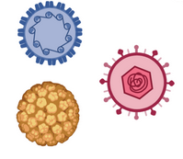
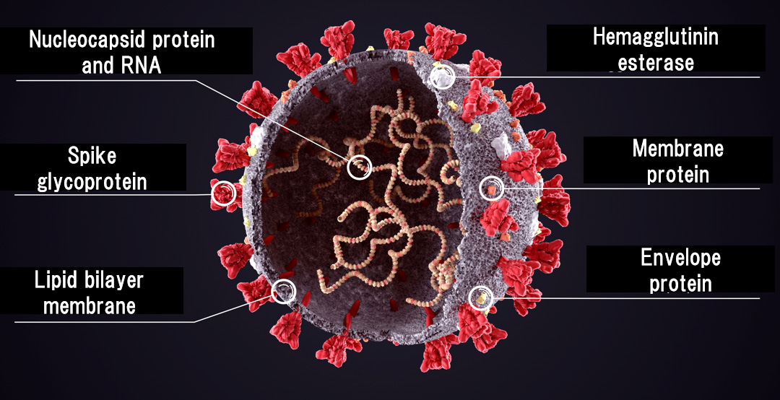
Year 1 Case Study: In Silico SARS-CoV-2 Variant Characterization
Classify
SARS-CoV-2 variants of concern fueled waves of infection throughout the pandemic
Many mutations remain uncharacterized outside of spike protein
SARS-CoV-2 nucleocapsid (N) protein:
Mutated in each variant of concern
Disrupts immune signaling by binding to cytokines (Lopez-Munoz et al., 2021)
Difficult to study experimentally
SARS-CoV-2 Wu1
SARS-CoV-2 Beta
SARS-CoV-2 DeltaA
SARS-CoV-2 DeltaJ
SARS-CoV-2 Alpha
SARS-CoV-2 Gamma
SARS-CoV-2 Omicron BA.1
SARS-CoV-2 Omicron BA.2.12.1
SARS-CoV-2 Omicron BA.2
SARS-CoV-2 XBB
SARS-CoV-2 Nucleocapsid Phylogenetic Tree
SARS-CoV-2 Omicron BA.2.75
SARS-CoV-2 Omicron BA.4
SARS-CoV-2 Omicron BA.5
0.002
SARS-CoV-2 BQ.1
MIT/LL team generated tree using neighbor-joining build method with Geneious algorithm with SARS-CoV-2 WA1 N-protein as the outgroup
Hypothesis: breadth and strength of cytokine binding has increased with new variants
64 cytokines with 15 variants = 960 combinations

Slide 3
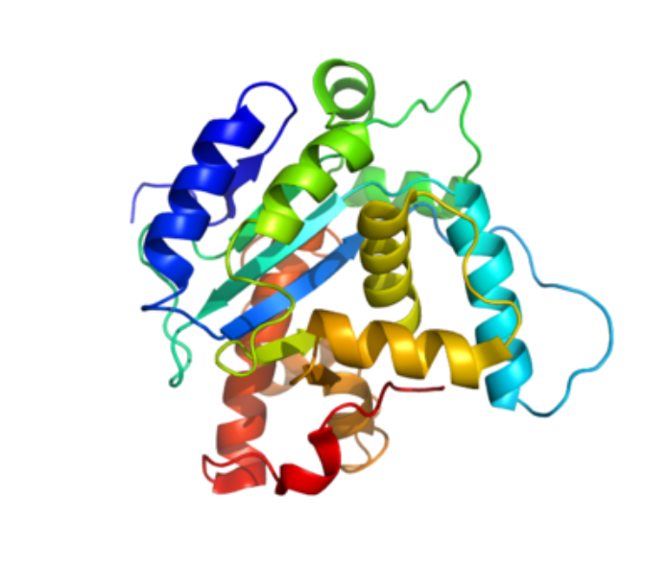
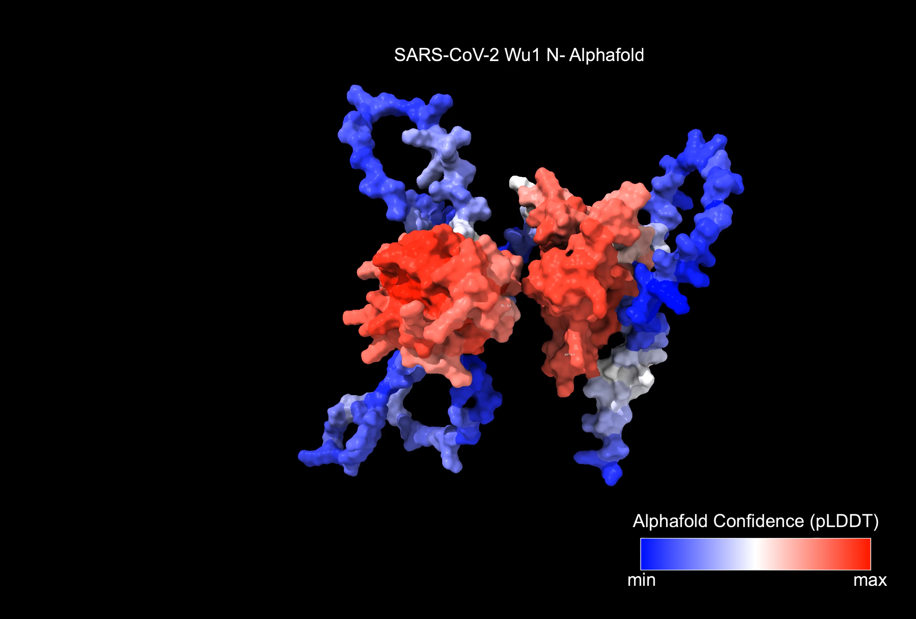
Generation of SARS-CoV-2 N Structure
Structure
Five competing structure algorithms were containerized and deployed to our high-performance computing cluster
AlphaFold2 (AF) [1] structure reproduces expected topology:
2 ordered domains with high confidence
3 disordered domains with low confidence
AF produces identical structure for SARS-CoV-2 N even if database inclusion is limited to pre-pandemic entries
SARS-CoV-2 Wu N - Alphafold
AF: AlphaFold2
[1] https://www.nature.com/articles/s41586-021-03819-2

Slide 4
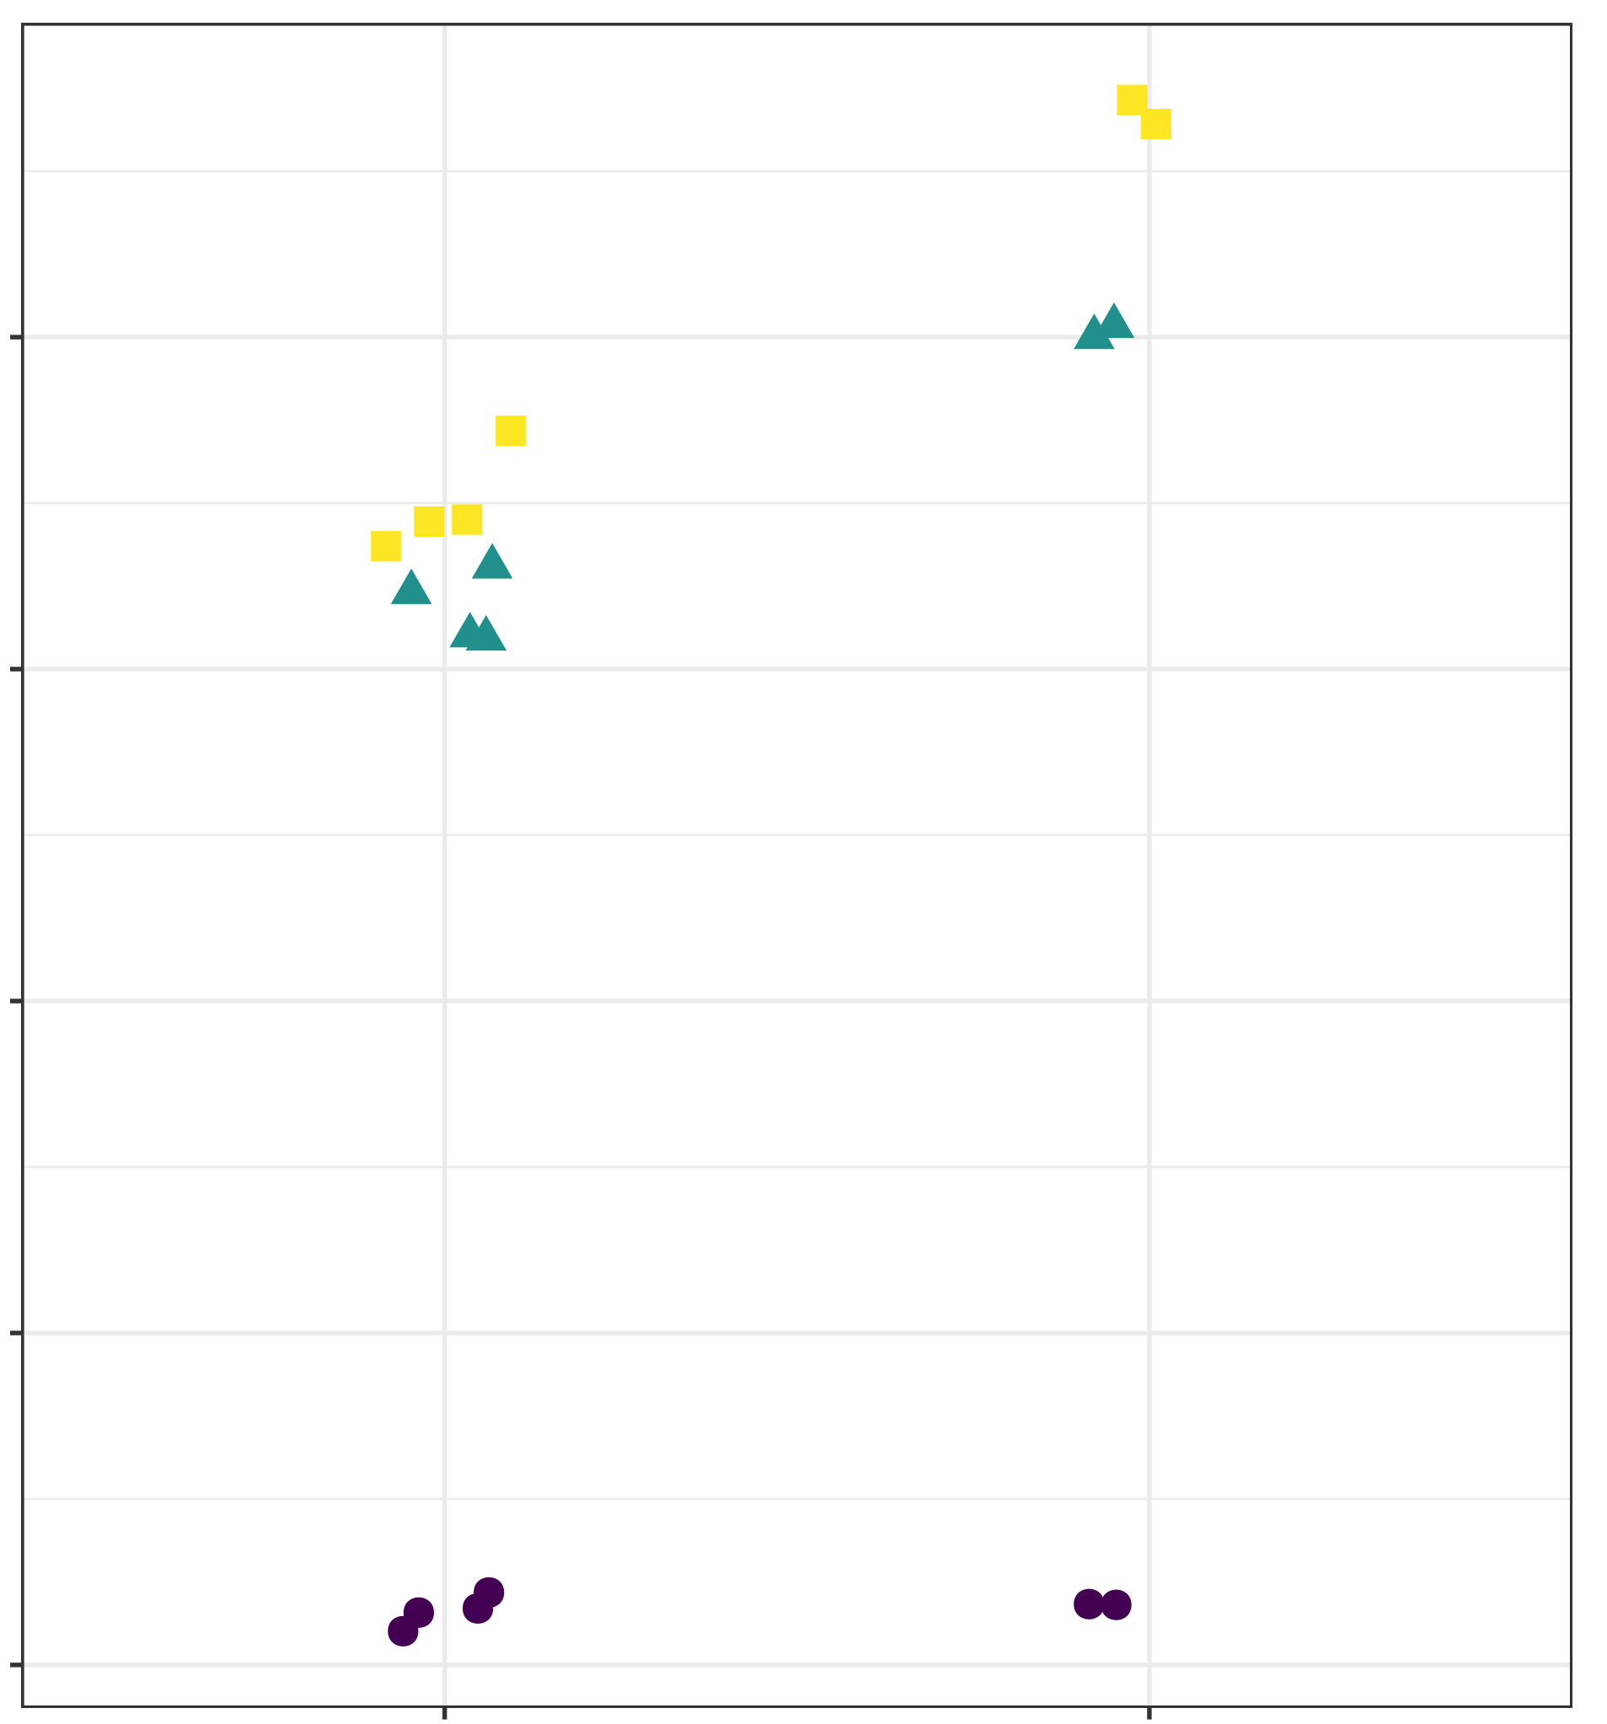
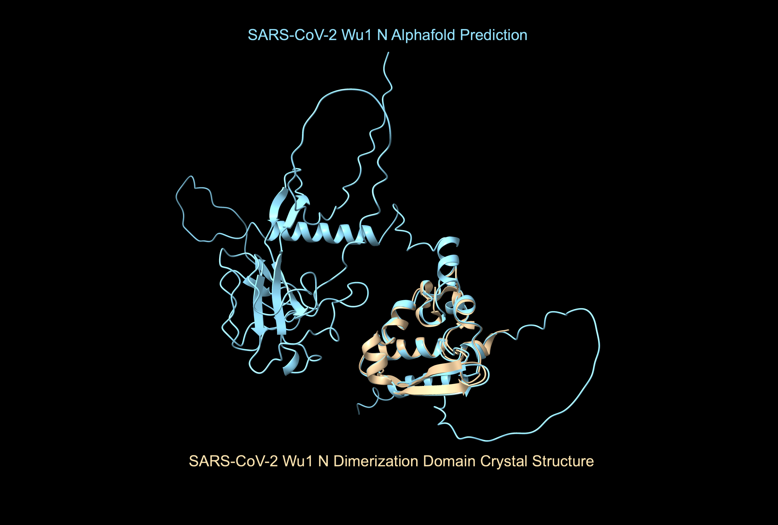
Generation of SARS-CoV-2 N Structure
Structure
Agreement of computationally derived structure with published crystal structures of SARS-CoV-2 domains
AF SARS-CoV-2 Wu1 N shows agreement with crystalized RNA-binding domain and dimerization domain
ESMfold [1] and OmegaFold [2] structures do not match experimental structures
20
SARS-CoV2 Wu1 N Alphafold Prediction
15
RMSD (angstrom)
10
Model
Alphafold
ESMfold
Omegafold
5
0
SARS-CoV2 Wu1 N Dimerization Domain Crystal Structure
RBD
Dimerization
Region
AF: AlphaFold2
[1] https://www.biorxiv.org/content/10.1101/2022.12.21.521521v1
[2] https://www.biorxiv.org/content/10.1101/2022.07.21.500999v1
RMSD: Root-mean sq. difference
RBD: Receptor binding domain

Slide 5
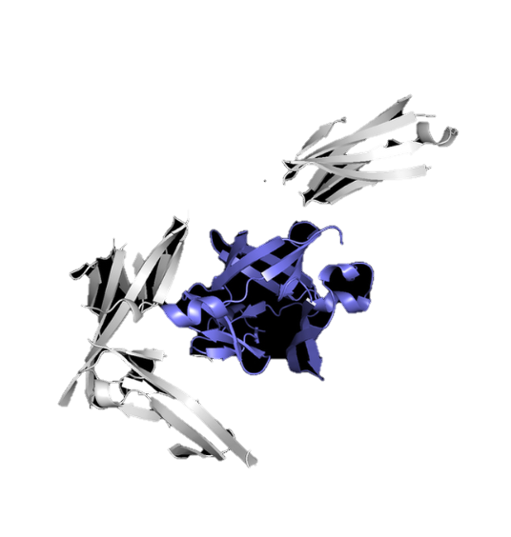
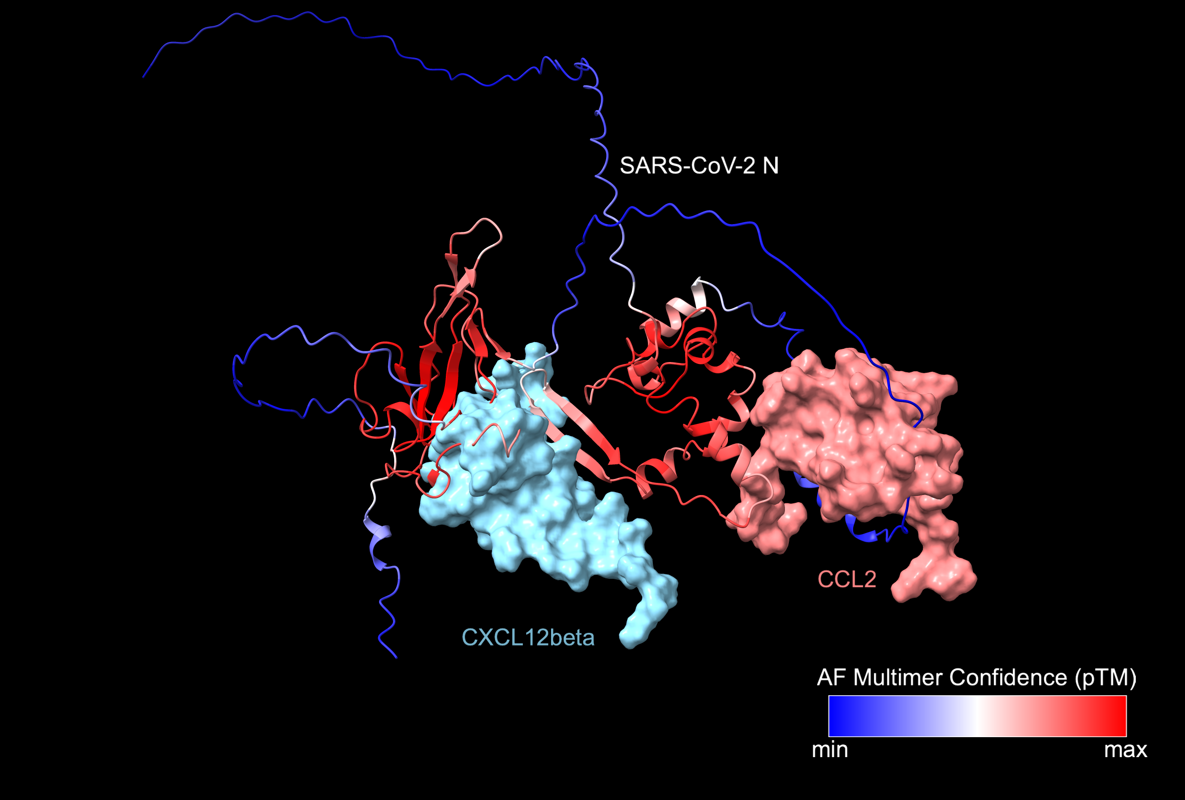
Evaluating Interactome of SARS-CoV-2 N
Docking
Docked 5 target cytokines and 5 non-target cytokines to SARS-CoV-2 N with AF-Multimer
Preliminary results show binding of target cytokines to structured regions of SARS-CoV-2 N
Constructing bioinformatics pipeline to measure strength of interaction between cytokines and SARS-CoV-2 N
Alternates include ClusPro [1] and DiffDock [2]
SARS-CoV-2 N
CCL 2
CXCL 12beta
Predicted Docking Confidences by GDockScore [3]:
CXCL12beta – 86%
CCL2 – 66%
State of the art for protein-protein interactions still under assessment
AF: AlphaFold2
[1] https://cluspro.org/help.php
[2] https://arxiv.org/abs/2210.01776
[3] https://www.biorxiv.org/content/10.1101/2022.12.02.518908v3

